Slide 1
Trajectory Tracking for Autonomous Vehicles using Sliding Mode Control
By
Harish N Sathishchandra
Ref:- R. Solea, U. Nunes, “Trajectory planning and sliding mode control based trajectory tracking for cybercars”

Slide 2
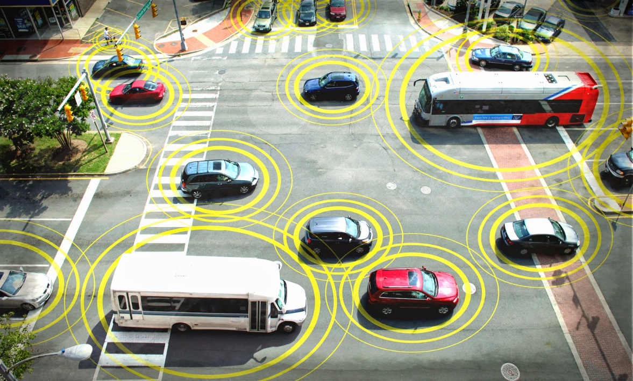
Introduction
Autonomous Vehicle is a vehicle
capable of sensing its environment
and navigating without human input.
Advantages –
Reduced road congestion
Improved road safety
Improved fuel efficiency.

Slide 3
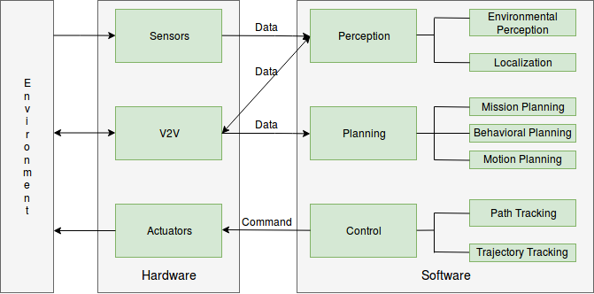
Overview of Autonomous Vehicle System
Notes:
V2V: vehicle to vehicle communication to achieve further improvements in perception and planning.
Env percep: mapping the environment and labelling
SLAM: combo of env percep and localization
Planning: making decisions to reach final goal
Control: robot’s ability to execute planed actions
Path tracking trajectory tracking difference: trajec track allows to specify desired state at each point in time whereas path track simply commands the car to follow a given path.
Actuator executes the command from control. An example is the steering column actuator to control the front wheel direction

Slide 4
Popular types of tracking methods
Geometric methods
Pure Pursuit
Stanley Method
Model based methods
Kinematic model based controllers
Dynamic model based controllers
Notes:
Geometric: use geometric relationships between vehicle and path to come up with control law. Make use of look ahead distance to measure error ahead of the vehicle, similar to humans, and can generate simple arc trajectory to more complicated trajectories involving screw theory.
Pure pursuit: geometrically calculates curvature of circular arc that connects rear axle to goal point on trajectory.
Stanley method: developed by Stanford Uni’s autonomous entry to DARPA grand challenge. Uses a nonlinear feedback function of the cross track error, measured from the center of the front axle to the nearest path point for which exponential convergence can be shown. Since it is using nonlinear feedback function, it is more suited for higher speeds than pure pursuit.
Model based methods use models of the vehicle to derive control laws. We are ging to use kinematic model to design a SMC

Slide 5

Motion model of vehicle
Kinematic Bicycle model:
$\overset{͘}{x}r\left(t\right)=vr\left(t\right) ·cosθr\left(t\right)…(1)$
$\overset{͘}{y}r\left(t\right)=vr\left(t\right) ·sinθr\left(t\right)…(2)$
$\overset{͘}{θ}r\left(t\right)=\frac{v_{r}}{l} ·tanφr\left(t\right)…(3)$
Notes:
A car can be simplified to a bicycle by joining front and back tires together at center of axles. The model we are going to use is shown here. Xr and Yr are Cartesian coordinates of rear axle midpoint, which is also the control point of our model. Vr is velocity of this midpoint. Thetar is vehicles heading angle. L is interaxle distance and phi_r front wheel angle.

Slide 6
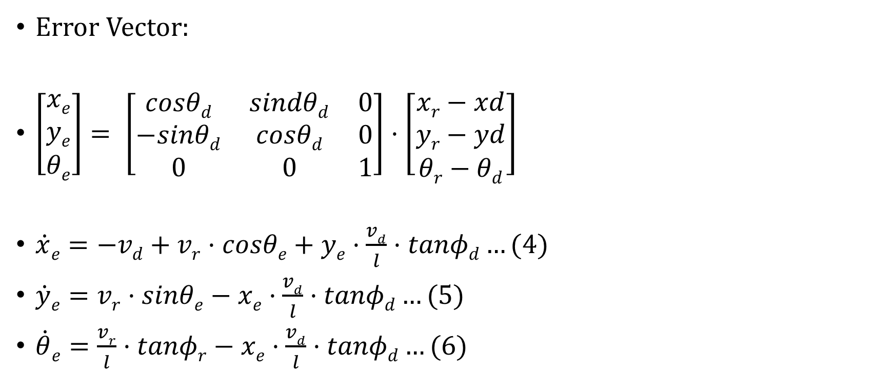
Error model
Error Vector:
$\left[\begin{aligned}xe \\ ye \\ θe\end{aligned}\right]= \left[\begin{matrix}cosθd & sindθd & 0 \\ −sinθd & cosθd & 0 \\ 0 & 0 & 1\end{matrix}\right]·\left[\begin{aligned}xr−xd \\ yr−yd \\ θr−θd\end{aligned}\right]$
$\dot{x}e=−vd+vr·cosθe+ye·\frac{vd}{l}·tanφd…(4)$
$\dot{y}e=vr·sinθe−xe·\frac{vd}{l}·tanφd…(5)$
$\dot{θ}e=\frac{vr}{l}·tanφr−xe·\frac{vd}{l}·tanφd…(6)$
Notes:
X_d, Y_d, Theta_d describe virtual car pose. V_d and phi_d are desired heading velocity and front wheel angle. Our aim is to design a stable controller to control V_c and phi_c, which are controller velocity and steering angle command.

Slide 7
Sliding Mode Control
Uses the concept of sliding surface to describe error space
AIM: make output variable track a desired profile
Advantages:
Closed loop response does not depend on uncertain nonlinearities.
Dynamic behavior of system depends on choice of sliding function.
Notes:
Aim is to make the output variable track the desired profile. So we are trying to drive the car to some small vicinity of zero error after some acceptable duration.
Motion on the manifold s = 0 is independent of nonlinear functions.
We can also control the dynamics of the vehicle by properly selecting the parameters of the sliding surface.

Slide 8
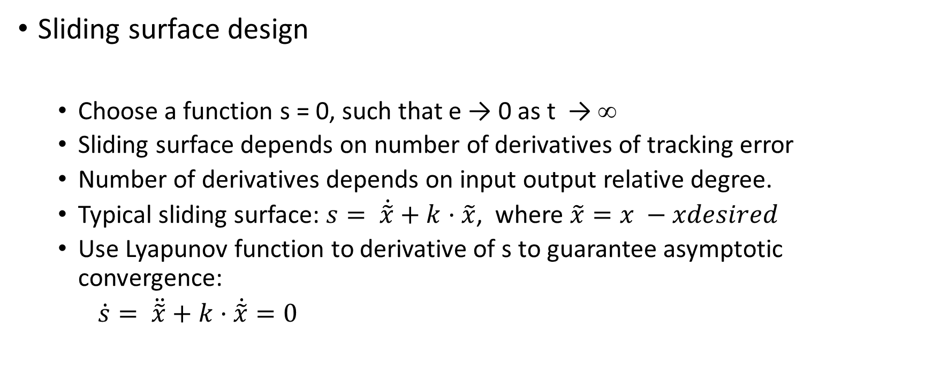
Design of sliding mode control
Sliding surface design
Choose a function s = 0, such that e → 0 as t 󠄒 → ∞
Sliding surface depends on number of derivatives of tracking error
Number of derivatives depends on input output relative degree.
Typical sliding surface: $s= \dot{\tilde{x}}+k·\tilde{x}$, where $\tilde{x}=x −xdesired$
Use Lyapunov function to derivative of s to guarantee asymptotic convergence:
$\dot{s}= \ddot{\tilde{x}}+k·\dot{\tilde{x}}=0$
Notes:
We want to design a manifold in the error space, which guarentees convergence. This can be achieved by setting the coefficient k to be positive.
The number of derivatives to be included depends on the relative degree. We should make sure that the derivative of the surface is a function of the control to design a successful controller.

Slide 9
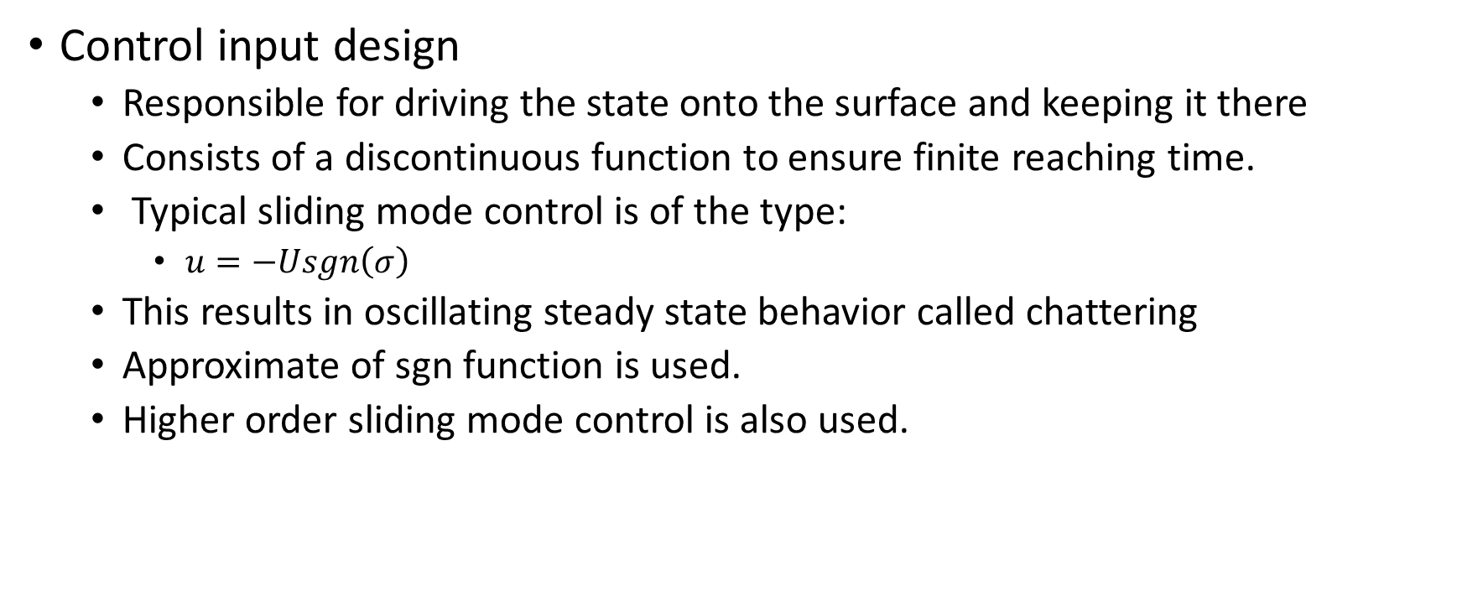
Design of sliding mode control
Control input design
Responsible for driving the state onto the surface and keeping it there
Consists of a discontinuous function to ensure finite reaching time.
Typical sliding mode control is of the type:
$u=−Usgn\left(σ\right)$
This results in oscillating steady state behavior called chattering
Approximate of sgn function is used.
Higher order sliding mode control is also used.
Notes:
In order to drive the state of a vehicle onto the manifold in a certain time, we use a discontinuous function, such as a sign function or sigmoid, to avoid chattering. The control law also holds the system in the manifold once it reaches.

Slide 10
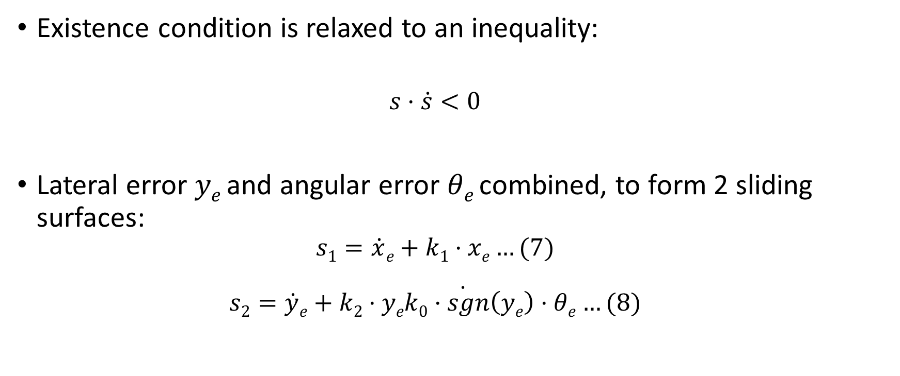
Proposed sliding surface
Existence condition is relaxed to an inequality:
$$s·\dot{s}<0$$
Lateral error $ye$ and angular error $θe$ combined, to form 2 sliding surfaces:
$$s1=\dot{x}e+k1·xe…(7)$$
$$s2=\dot{\dot{y}e+k2·yek0·sgn\left(ye\right)·θe…(8)}$$
Notes:
There are 2 sliding surfaces, since there are 2 control variables. Hence we combine Y_e and Theta_e in one sliding surface.

Slide 11
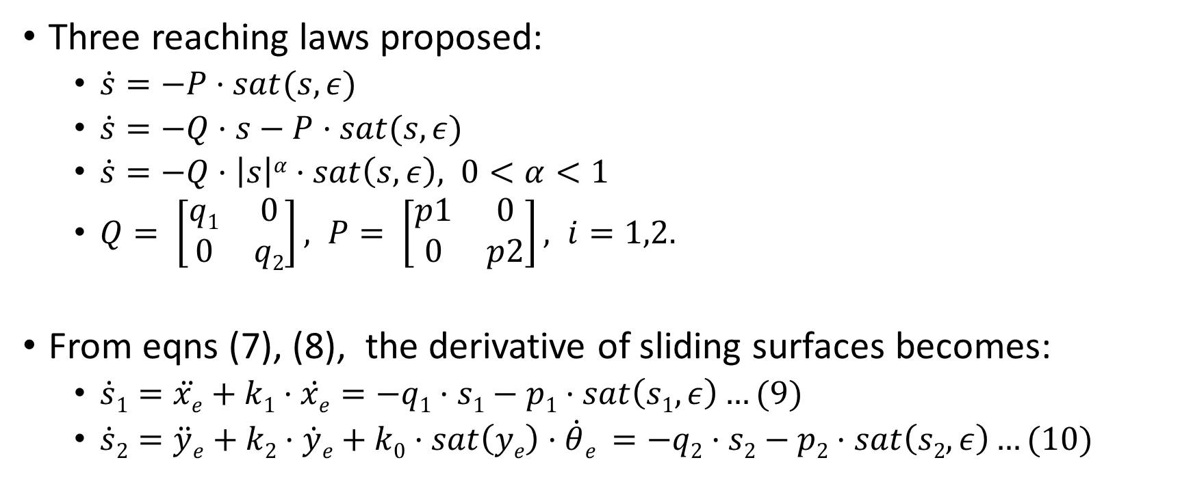
Proposed control law
Three reaching laws proposed:
$\dot{s}=−P·sat(s,ε)$
$\dot{s}=−Q·s−P·sat(s,ε)$
$\dot{s}=−Q·\left|s\right|α·sat\left(s,ε\right), 0<α<1$
$Q= \left[\begin{matrix}q1 & 0 \\ 0 & q2\end{matrix}\right], P= \left[\begin{matrix}p1 & 0 \\ 0 & p2\end{matrix}\right], i=1,2.$
From eqns (7), (8), the derivative of sliding surfaces becomes:
$\dot{s}1=\ddot{xe}+k1·\dot{xe}=−q1·s1−p1·sat\left(s1,ε\right)…(9)$
$\dot{s}2=\ddot{y}e+k2·\dot{y}e+k0·sat\left(ye\right)·\dot{θ}e =−q2·s2−p2·sat\left(s2,ε\right)…(10)$
Notes:
First law forces the switching variable to reach the switching surface at constant time. 2nd the state is forced to approach the manifold faster when error is large. 3rd increases reaching speed when state is far away from switching manifold and decreases as it approaches. I decided to implement the 2nd proportional controller.

Slide 12
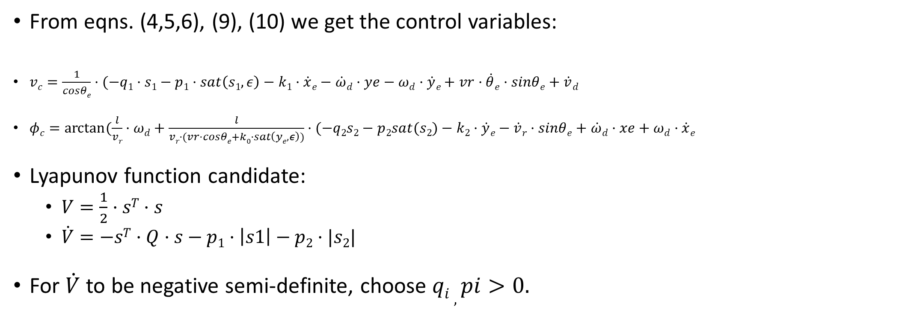
Control Variables and stability
From eqns. (4,5,6), (9), (10) we get the control variables:
$vc=\frac{1}{cosθe}·(−q1·s1−p1·sat\left(s1,ε\right)−k1·\dot{x}e−\dot{ω}d·ye−ωd·\dot{y}e+vr·\dot{θ}e·sinθe+\dot{v}d$
$φc=arctan⁡(\frac{l}{vr}·ωd+\frac{l}{vr·(vr·cosθe+k0·sat\left(ye,ε\right))}·(−q2s2−p2sat(s2)−k2·\dot{y}e−\dot{v}r·sinθe+\dot{ω}d·xe+ωd·\dot{x}e$
Lyapunov function candidate:
$V=\frac{1}{2}·sT·s$
$\dot{V}=−sT·Q·s−p1·\left|s1\right|−p2·|s2|$
For $\dot{V}$ to be negative semi-definite, choose $qi , pi>0.$
Notes:
V_c is the commad velocity, Q and P are parameters that is used to ensure uniform stability. Omega_d is the desired angular velocity.

Slide 13
Implementation block diagram
Notes:
V_c and omega_c are corrected velocities and angular velocities. Phi_c is the steering angle. H is a transfer function that transforms steering angle into front wheel angle.. Since phi_r is the rate of change of heading of the vehicle, it is integrated to get the heading of the vehicle.

Slide 14
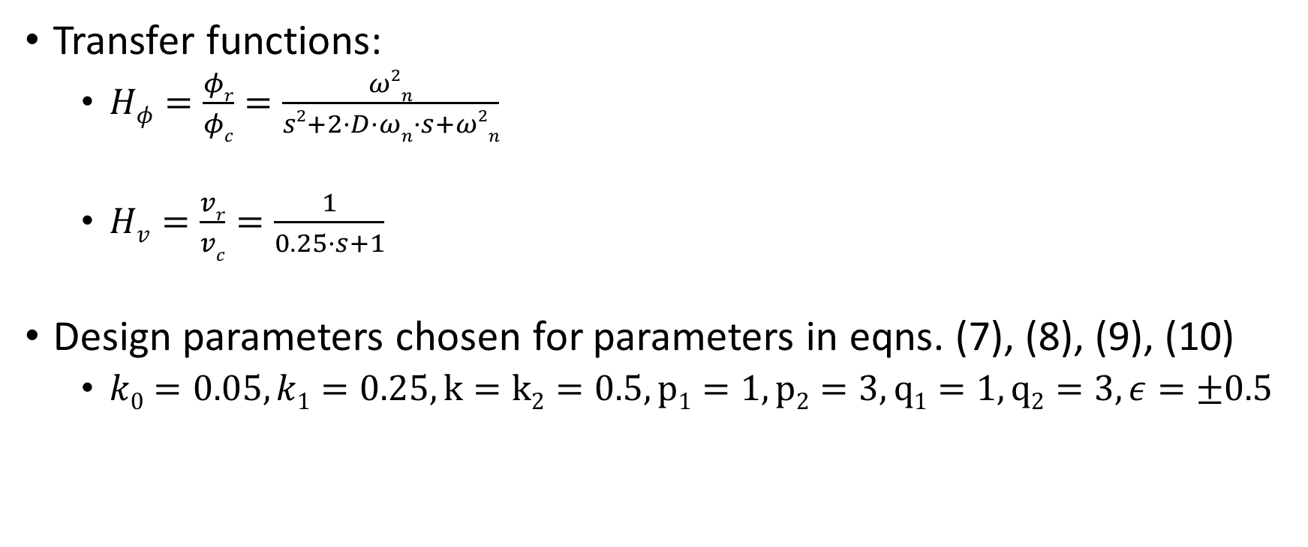
Implementation parameters
Transfer functions:
$Hφ=\frac{φr}{φc}=\frac{ω2n}{s2+2·D·ωn·s+ω2n}$
$Hv=\frac{vr}{vc}=\frac{1}{0.25·s+1}$
Design parameters chosen for parameters in eqns. (7), (8), (9), (10)
$k0=0.05, k1=0.25, k=k2=0.5, p1=1, p2=3, q1=1, q2=3, ε=±0.5$

Slide 15
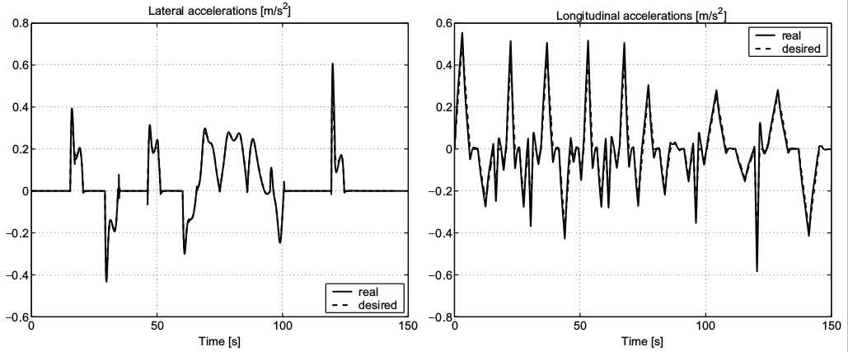
Test Case
Without initial deviation:

Slide 16
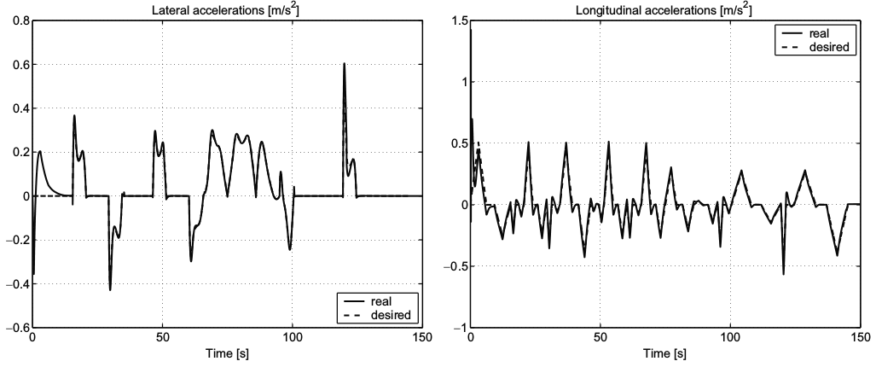

Test Case
With initial pose error of $xr\left(0\right)=1, yr\left(0\right)=9, θr\left(0\right)=\frac{π}{8}:$
Notes:
The time taken to converge to zero is approx. 20 secs, after which it is the same as without pose error.

Slide 17
Future work
Test SMC for lane changing, figure eight and real world track.
Include test cases of low road adhesion and model parameter mismatches.
Average performance under measurement errors, like Gaussian noise.

Slide 18
References
R. Solea, U. Nunes, “Trajectory planning and sliding mode control based trajectory tracking for cybercars”
J.M.Snider, “Automatic steering methods for autonomous automobile path tracking”
S.Spurgeon, “Sliding mode control : a tutorial”
J.M.Yang, J.H.Kim, “Sliding Mode Control for Trajectory Tracking of Nonholonomic Wheeled Mobile Robots”
H.K.Khalil, Nonlinear Systems, 3rd edition

Slide 19
Thank you

